Slide 1

SIDDHARTH INSTITUTE OF ENGINEERING & TECHNOLOGY
(AUTONOMOUS)
(Approved by AICTE, New Delhi & Affiliated to JNTUA, Ananthapuramu)
(Accredited by NBA for Civil, EEE, Mech., ECE & CSE
Accredited by NAAC with ‘A+’ Grade)
Puttur -517583,Tirupathi District, A.P. (India)
DEPARTMENT OF
CSE (ARTIFICIAL INTELLIGENCE)
Academic Year 2025-26
Project Viva-Voce Examinations Date : 10.04.2026
Title of Project
Towards Green and Trustworthy 6G:Federated Learning Approaches for Robust Privacy.
Batch Details
S.NO: | REG NO | NAME | INTERNAL GUIDE
1 | 22F61A3114 | C S MADESH | K EZHILARASI M.Tech Assistant Professor
2 | 22F61A3119 | D MOUNIKA
3 | 23F65A3101 | K ADIMURTHY
4 | 23F65A3106 | T VIJENDRA

Slide 2
OBJECTIVE
1. This project aims to build a privacy-focused machine learning system for future 6G networks.
2. Instead of collecting all data in one place, it uses Federated Learning (FL), where multiple devices train a model together without sharing their raw data. This helps in:
> Protecting user privacy
> Reducing network traffic
3. A Flask-based web application is developed where users can:
> Register and log in
> Upload beamforming datasets
> Choose machine learning algorithms
> Get real-time predictions
4. The system works by simulating FL training rounds, where model updates from different devices are securely combined (averaged) to improve performance.
5.Overall, the project shows how Federated Learning can efficiently support intelligent and secure systems in 6G networks.

Slide 3
ABSTRACT
1. 6G technology will connect billions of smart devices and provide very fast communication (low latency) for advanced applications like autonomous vehicles and holograms.
2. Traditional AI systems rely on sending data to the cloud, which:
> Overloads the network
> Risks user privacy
3. To solve this, this project uses Federated Learning (FL), where:
Devices train models locally
Only encrypted updates are shared with a central server
4. A Flask-based web application is developed where users can:
> Register and log in
> Upload beamforming datasets
> Select algorithms like Random Forest, CNN, MLP, etc.
> Get real-time prediction results

Slide 4
LITERATURE REVIEW
Title of the Paper | Authors | Year | Implications
Blockchain empowered Federated Learning for 6G. | Xu et al. | 2023 | Combine FL with blockchain for traceability and trust in 6G; emphasizes audit trails and secure updates.
Federated Learning for Edge Intelligence in 6G Networks. | Yang et al. | 2022 | Overview of enabling FL in 6G, covers latency, non-IID issues, and model convergence.
Federated Learning in 6G: A Survey on Enabling Technologies. | Luong et al. | 2021 | In-depth survey on FL challenges and architectures in 6G ecosystems.

Slide 5
Title of the Paper | Authors | Year | Implications
Adaptive Federated Learning in Resource Constrained Edge Systems. | Wang et al. | 2021 | Proposes adaptive scheduling strategies to handle client heterogeneity and stragglers
Practical Secure Aggregation for Privacy-Preserving ML. | Bonawitz et al. | 2021 | Introduces secure aggregation protocols enabling privacy-preserving global model updates.
Federated Learning for Edge Intelligence: Applications and Challenges | Zhang et al. | 2021 | Highlights edge-based FL deployment, communication savings, and scalability.

Slide 6
EXISTING SYSTEM
Limitations of Traditional AI Systems (6G)
Uses centralized cloud-based training
Devices send raw data to central servers continuously
Major Problems
Network congestion: Massive real-time data overloads backhaul links
High latency: Delays make it unsuitable for real-time applications (autonomous driving, AR/VR)
Privacy risks: Sensitive user data is exposed during transmission and storage
Not scalable: Cannot efficiently support billions of 6G edge devices
No personalization: Models are generic and not adapted to local device data
High energy consumption: Continuous data transmission drains device and network resources
Security vulnerabilities: Prone to attacks like data leakage, model poisoning, and reconstruction attacks
Single point of failure: Central server failure affects the entire system
Traditional AI systems are inefficient, insecure, and not suitable for scalable 6G environments, highlighting the need for decentralized approaches like Federated Learning.

Slide 7
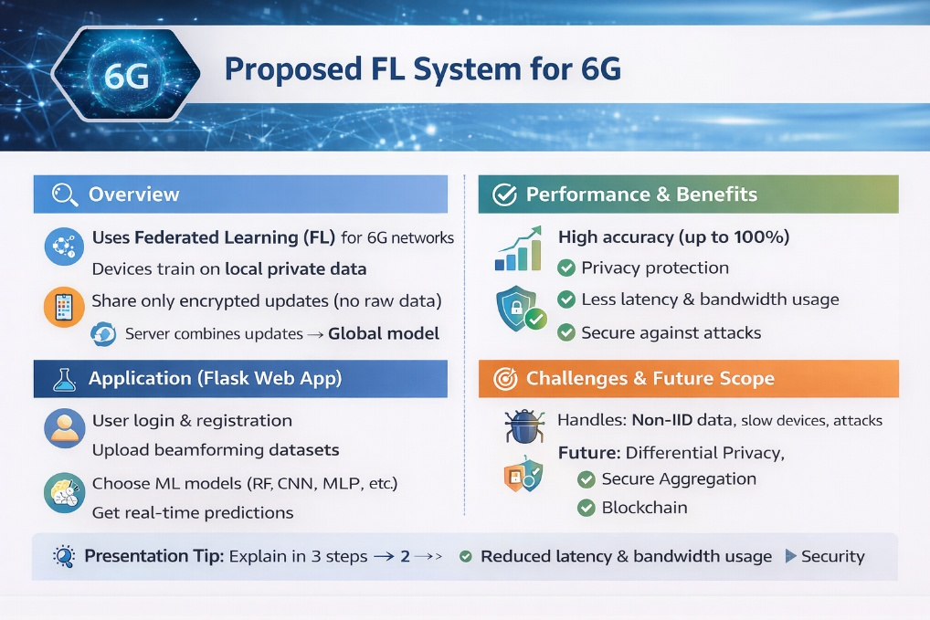
PROPOSED SYSTEM
Overview
Uses Federated Learning (FL) for 6G networks
Devices train on local private data
Share only encrypted updates (no raw data)
Server combines updates → Global model
Application (Flask Web App)
User login & registration
Upload beamforming datasets
Choose ML models (RF, CNN, MLP, etc.)
Get real-time predictions
Performance & Benefits
High accuracy (up to 100%)
Privacy protection
Less latency & bandwidth usage
Secure against attacks
Challenges & Future Scope
Handles: Non-IID data, slow devices, attacks
Future: Differential Privacy, Secure Aggregation, Blockchain

Slide 8
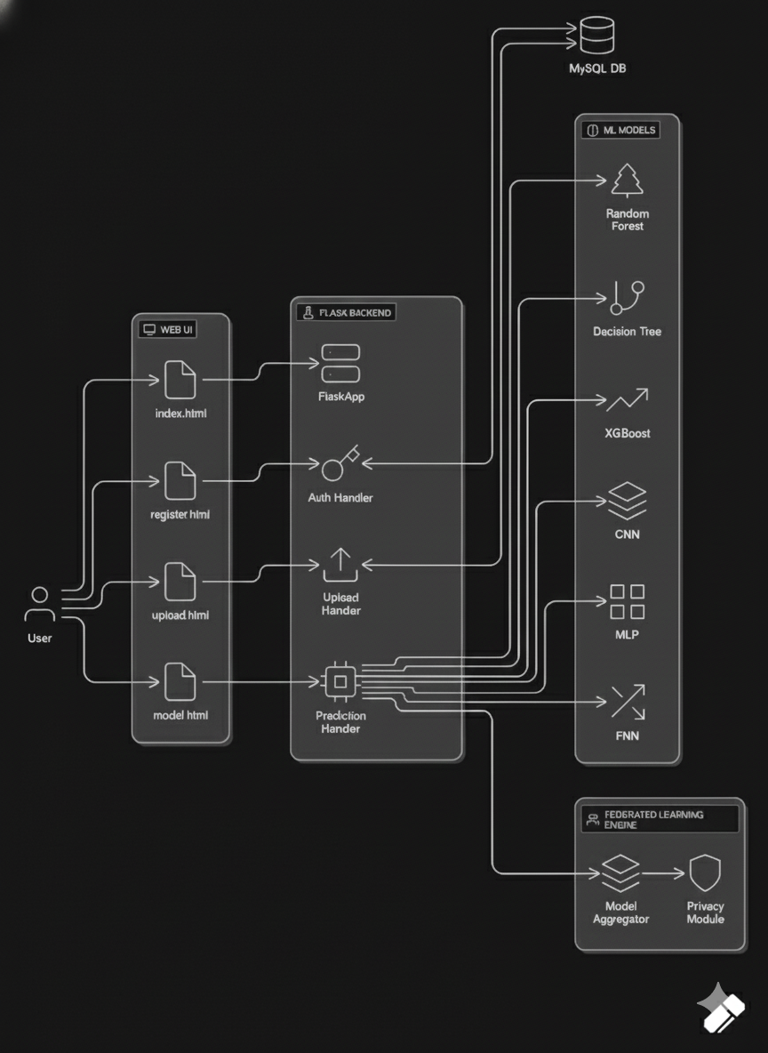
ARCHITECTURE DIAGRAM

Slide 9
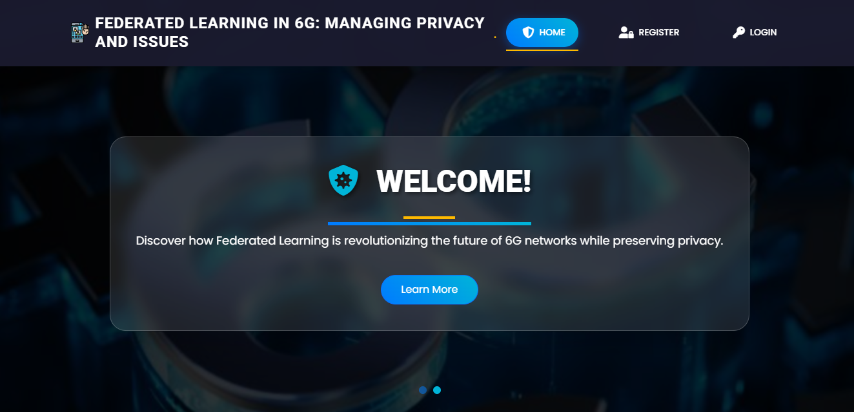
MODULES
HOME PAGE:The Home Page serves as the landing page of your application.
It provides an overview of the project's features, objectives, and benefits. Users can navigate to other sections of the application from this page.

Slide 10
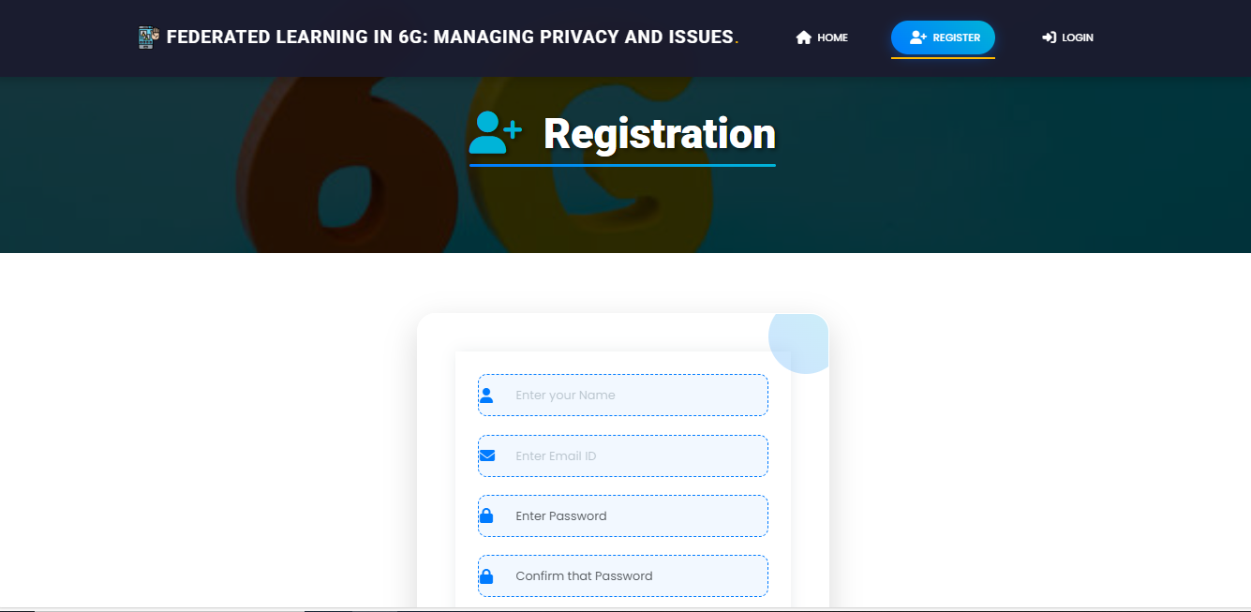
REGISTRATION PAGE: The Registration Page allows new users to create an account with the application. It typically includes fields for entering personal information such as name, email,password, and possibly other details like phone number or address. Users need to fill out this form to gain access to the application's features.

Slide 11
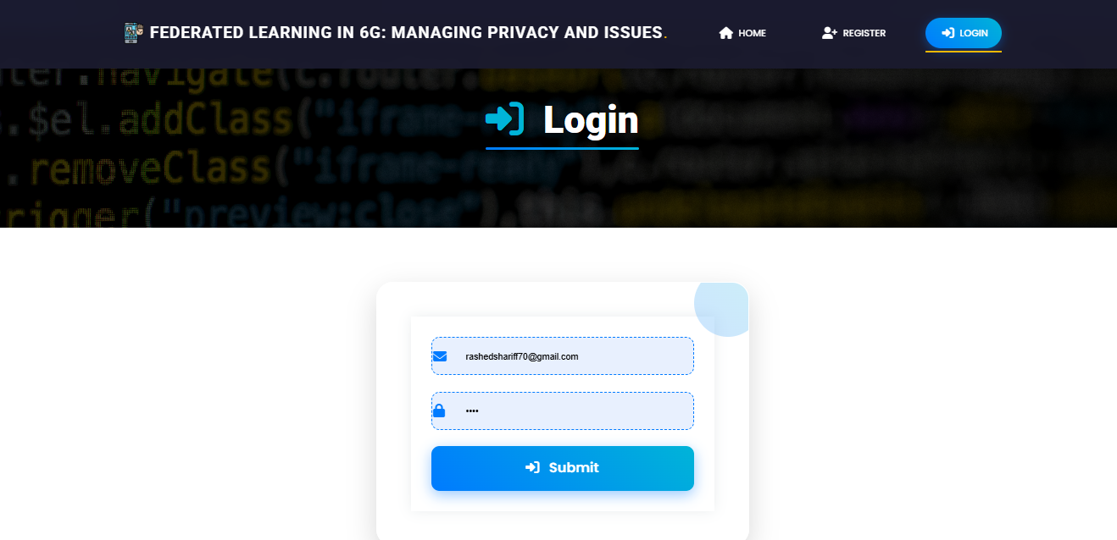
LOGIN: The login page allows registered users to securely access the application. User have to provide register email and password.

Slide 12
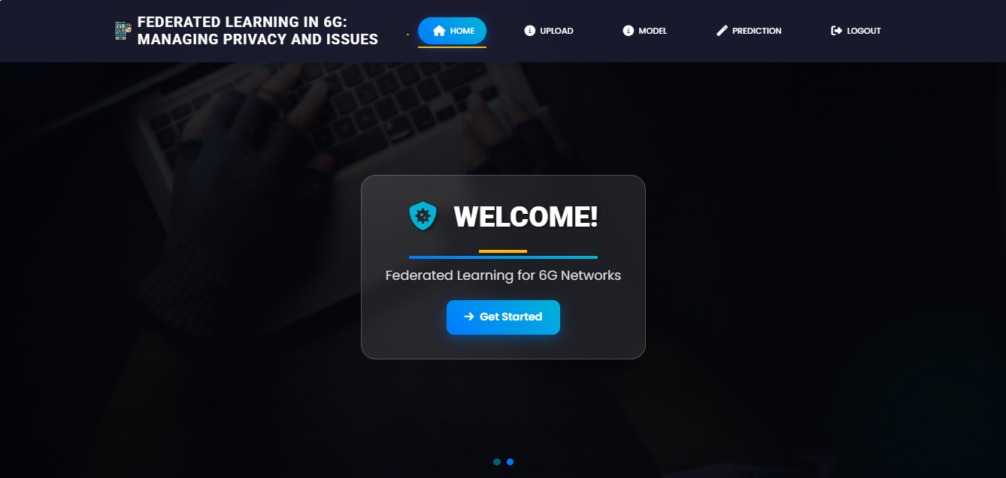
HOME PAGE AFTER LOGIN

Slide 13
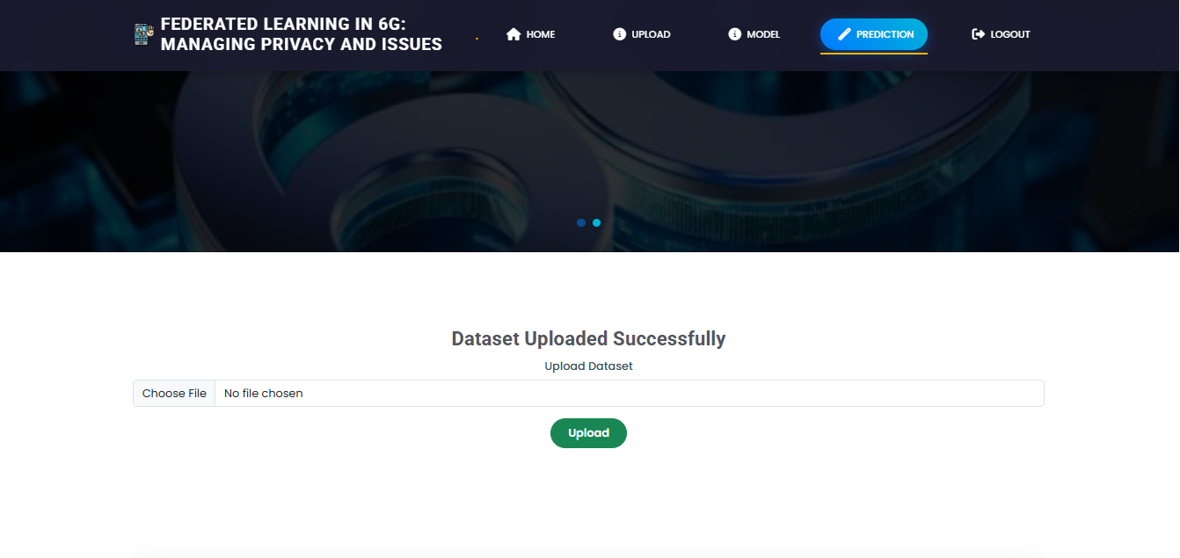
UPLOAD PAGE: Here you can upload the dataset and view the dataset

Slide 14
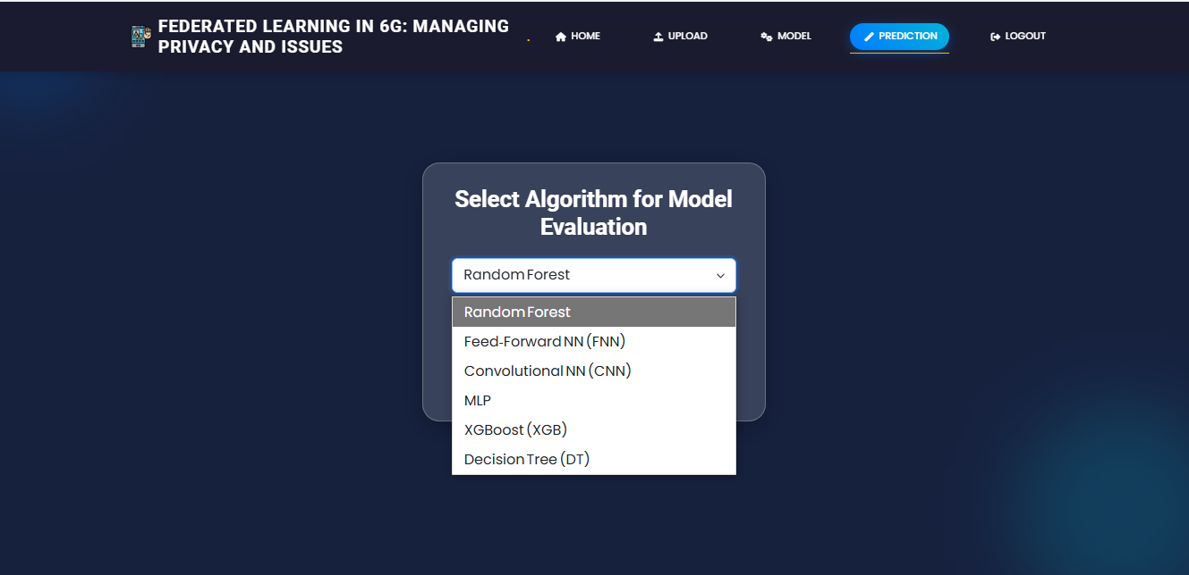
MODEL SELECTION: Here user have to select the model and email, password view the accuracy so that we know which algorithm is giving the highest accuracy.

Slide 15
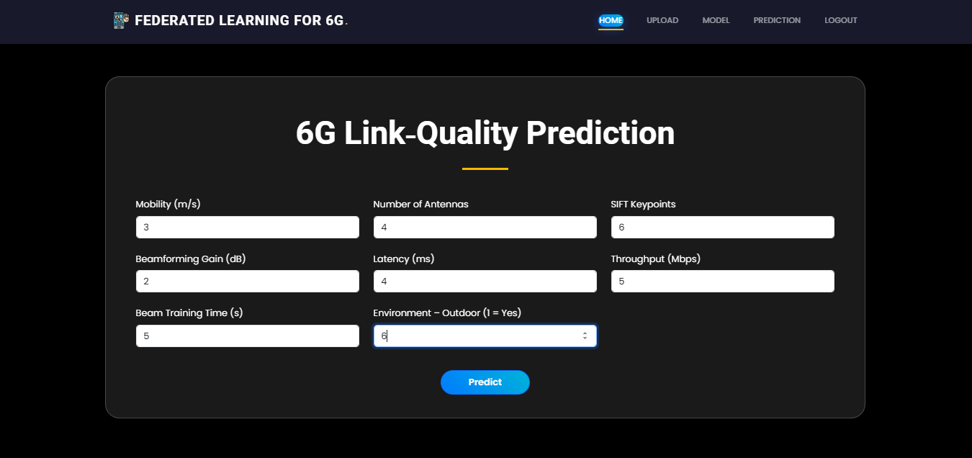
PREDICTION PAGE: This is the prediction page here user have to provide values of a 20 features and our model is predict the final output.

Slide 16
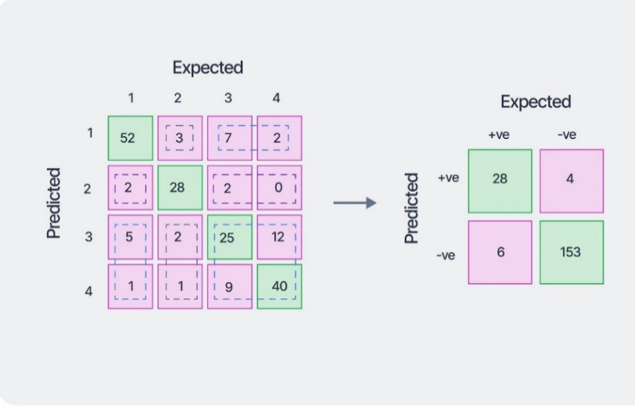
RESULT EVALUATION
PREDICTION OUTCOME
Models classified beamforming results as Success or Failure
Evaluation performed under simulated federated learning rounds
No raw data shared; only model parameters aggregated
Performance Results
Decision Tree, Random Forest, XGBoost
→ 100% accuracy in predicting Success/Failure
FNN, CNN, MLP
→ High accuracy with minor misclassification
Confusion Matrix Insight
Tree-based models showed:
  Zero false positives
  Zero false negatives
Indicates perfect beamforming decision reliability
Federated Learning Impact
✔ Preserved data privacy
✔ Reduced communication overhead
✔ Maintained centralized-model-level accuracy

Slide 17
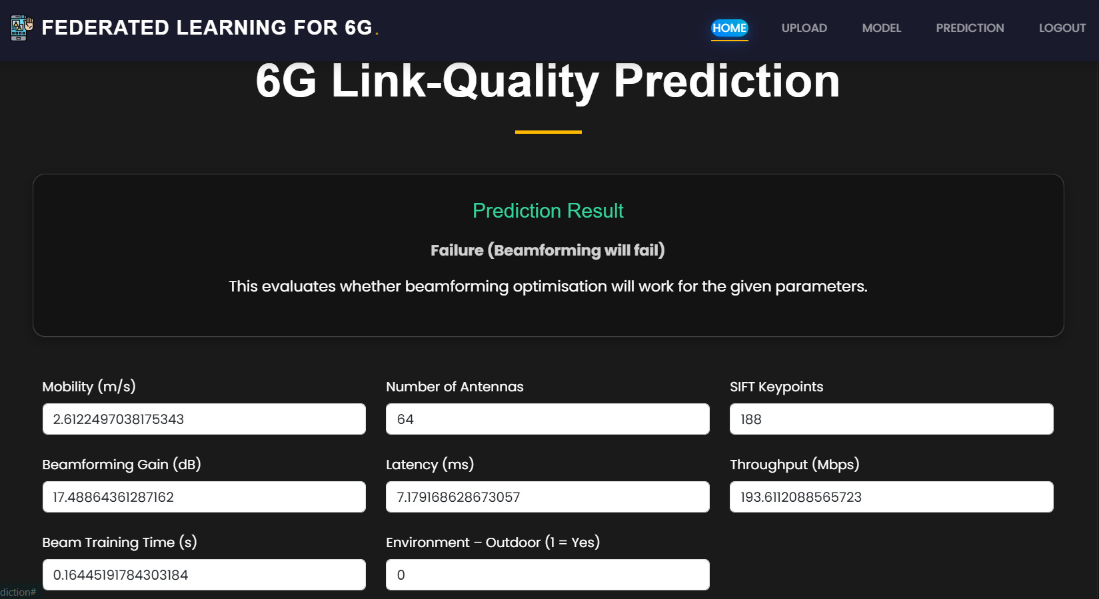
RESULT PAGE :After prediction show whether the beamforming will success or failure.

Slide 18
CONCLUSION
This project proposes a privacy-preserving federated learning framework to predict 6G beamforming success or failure. Traditional cloud-based ML systems face latency, scalability, and privacy issues, making them unsuitable for future 6G applications like autonomous mobility and holographic communication.
Our system uses Federated Learning, where edge devices train models locally and share only model parameters, ensuring data privacy. The framework is implemented using Python Flask with features such as secure authentication, dataset upload, model selection, and real-time prediction.
Six ML models are supported: Random Forest, XGBoost, FNN, CNN, MLP, and Decision Tree.
Tree-based models achieved 100% accuracy in simulations, proving their effectiveness for beamforming classification

Slide 19
REFERENCES
McMahan, B., Moore, E., Ramage, D., Hampson, S., & y Arcas, B. A. (2017). Communication-Efficient Learning of Deep Networks from Decentralized Data. Proceedings of the 20th International Conference on Artificial Intelligence and Statistics (AISTATS), PMLR. https://arxiv.org/abs/1602.05629
• Kairouz, P., McMahan, H. B., et al. (2021). Advances and Open Problems in Federated Learning. Foundations and Trends in Machine Learning, 14(1–2), 1–210. https://doi.org/10.1561/2200000083
• Zhu, H., Liu, Y., Zhou, Z., & Zhang, Y. (2020). Toward Efficient and Privacy-Preserving Federated Deep Learning. IEEE Network, 34(5), 16–22. https://doi.org/10.1109/MNET.001.1900664
• Niknam, S., Sharma, P. K., Anpalagan, A., Choudhury, N., & Pandey, A. (2020). Federated Learning for Wireless Communications: Motivation, Opportunities, and Challenges. IEEE Communications Magazine, 58(6), 46–51. https://doi.org/10.1109/MCOM.001.1900831

